Slide 1

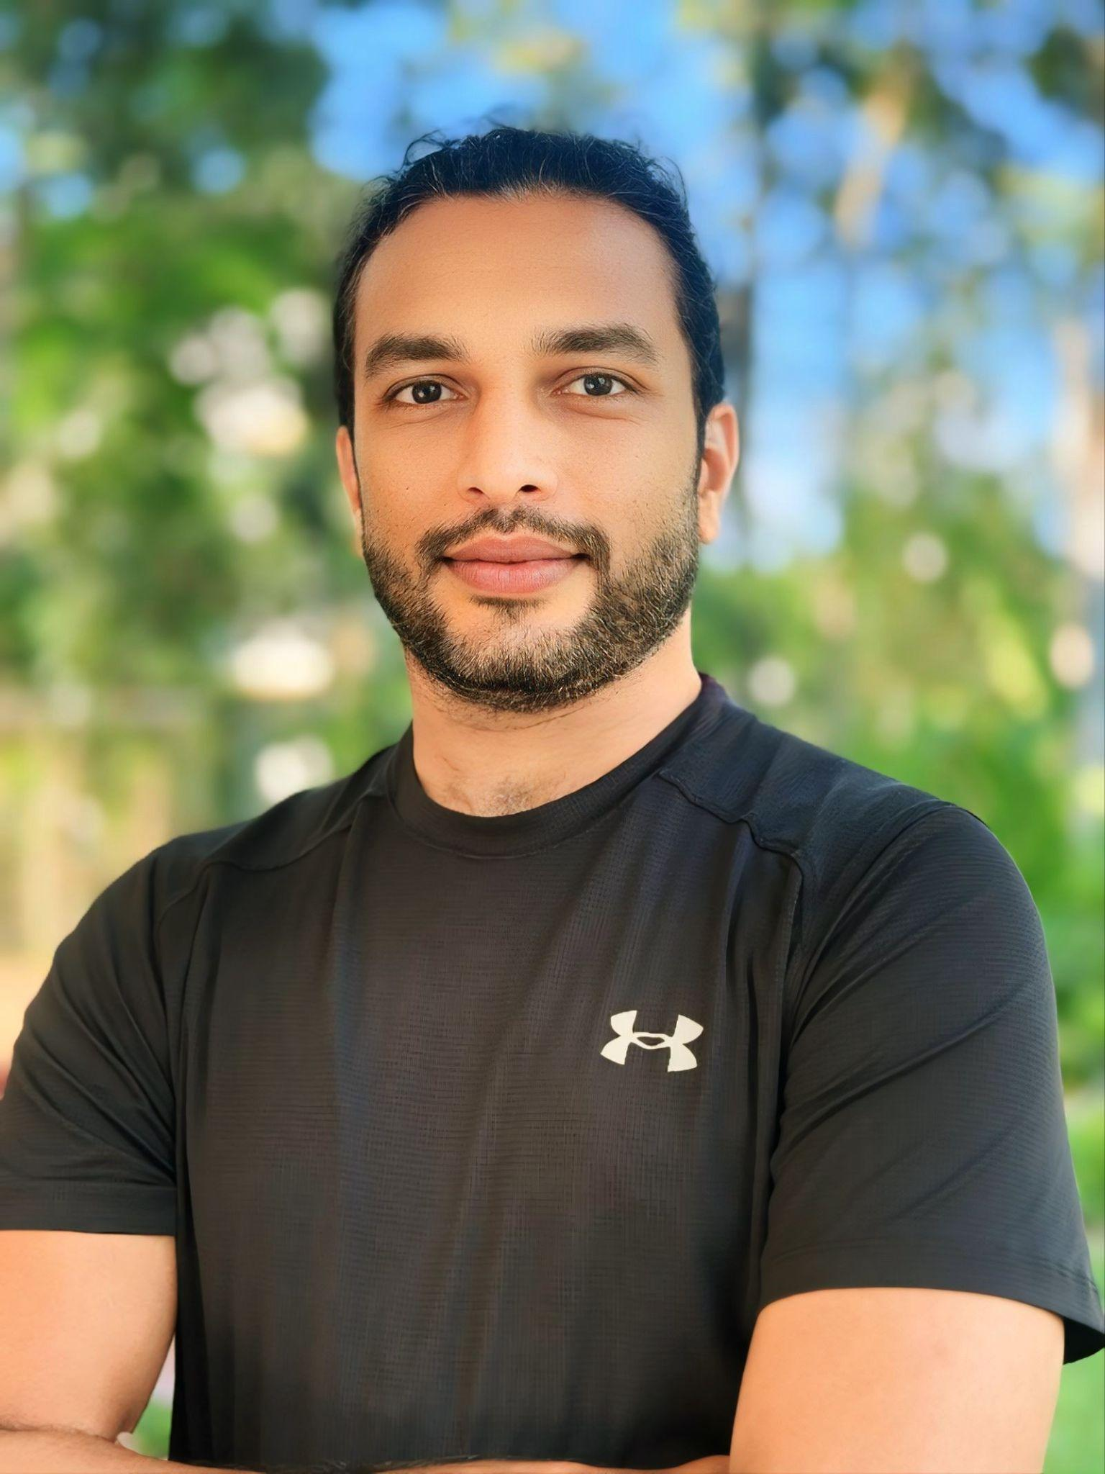
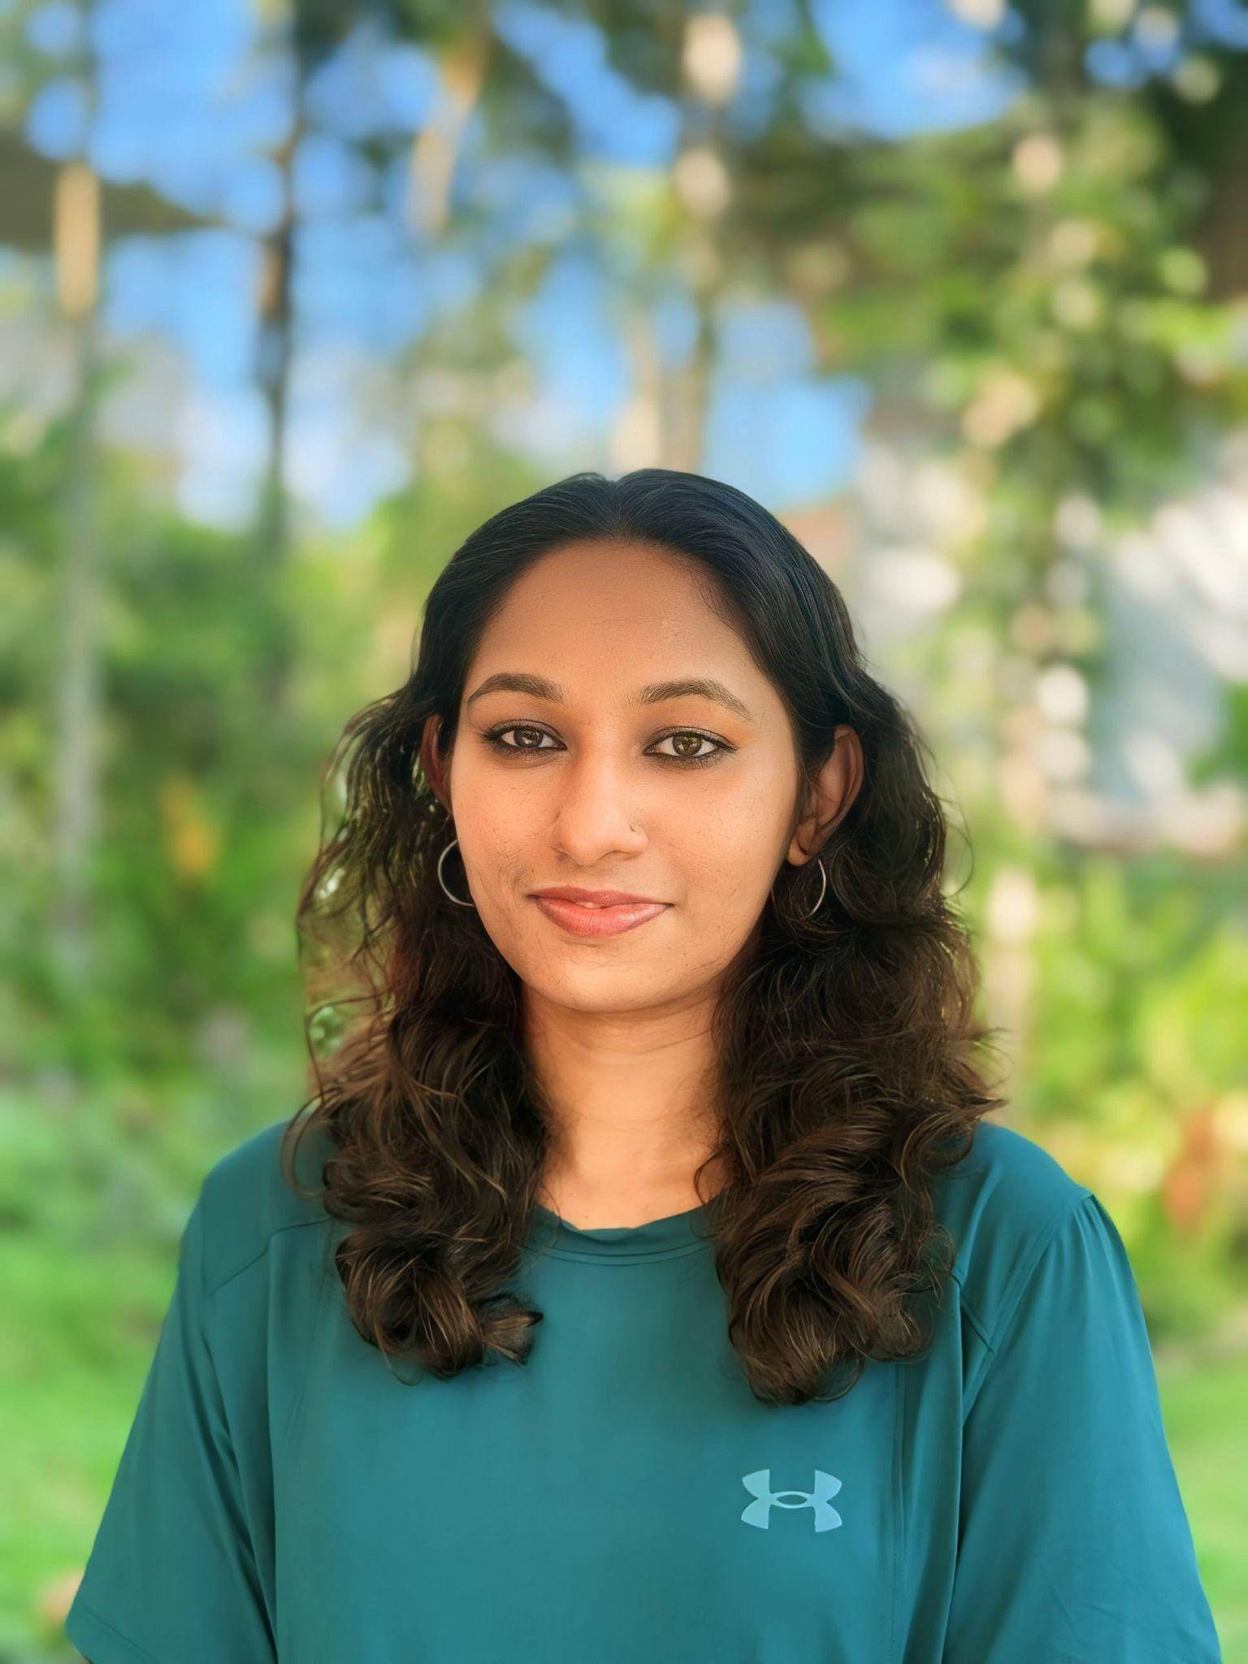
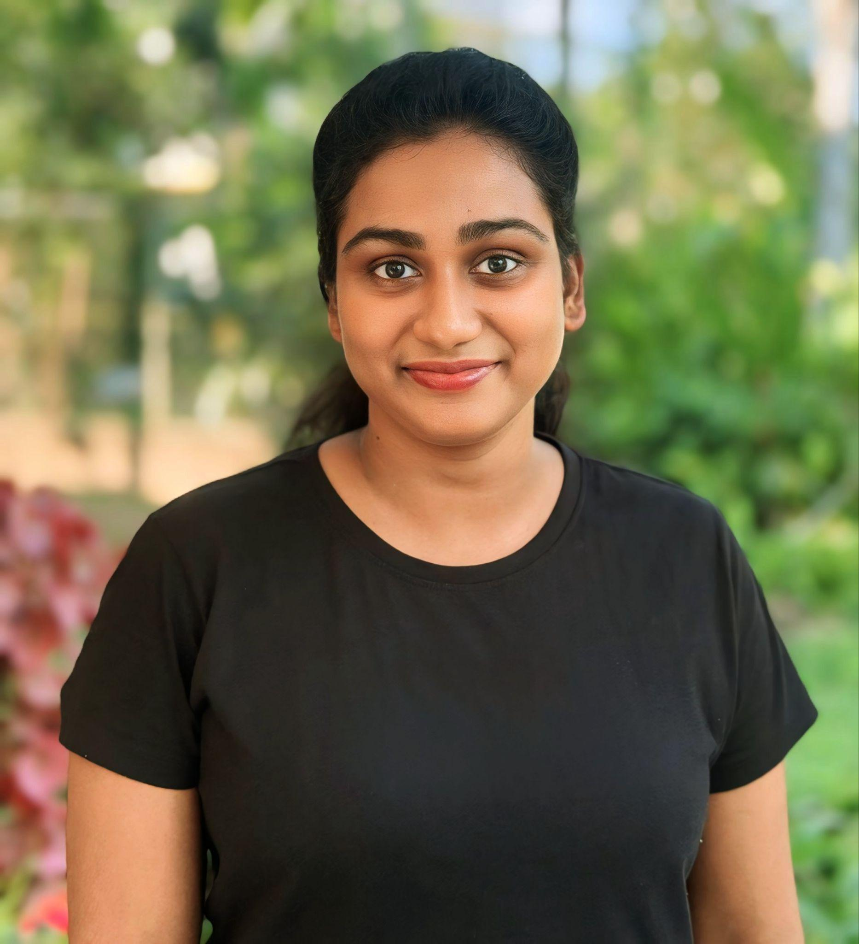
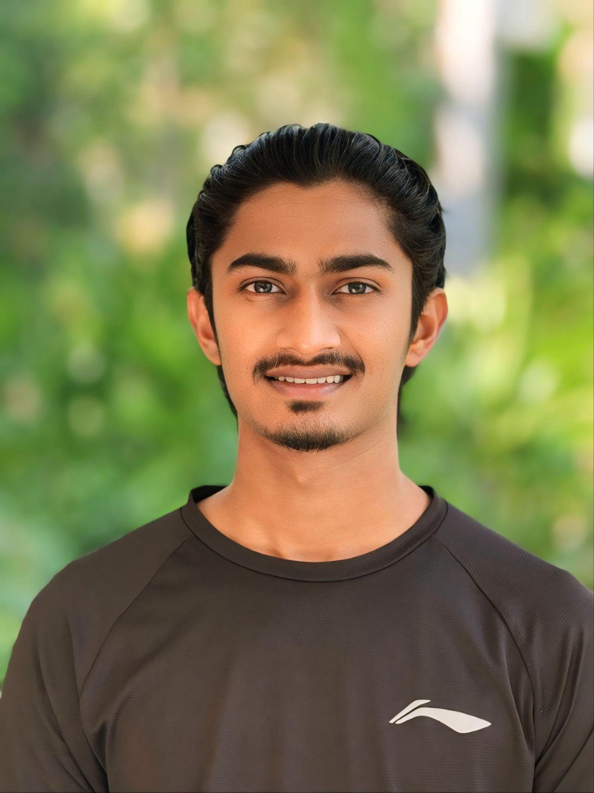
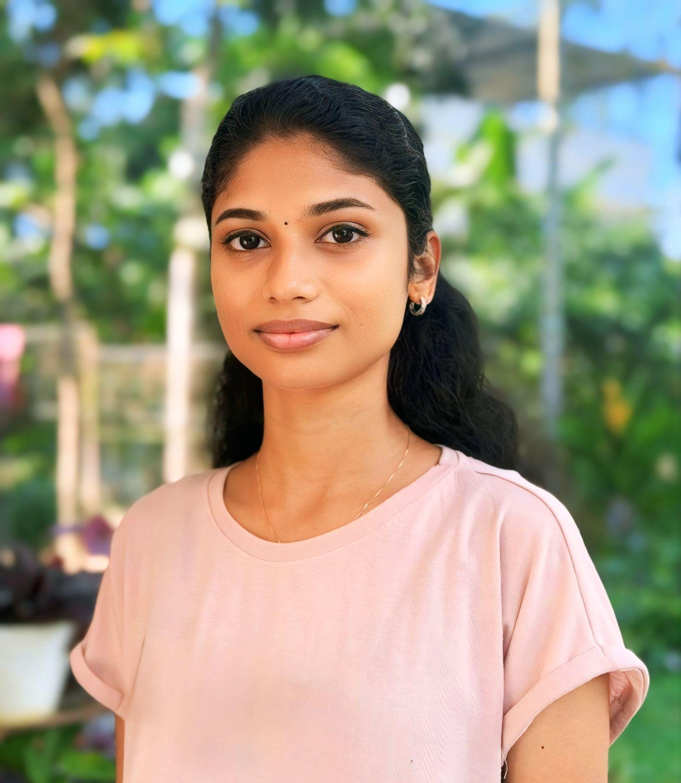
OUR TEAM
PHYSIOTHERAPY
DR. SANJITH G S
Head of Physiotherapy
Founder Director Sat Spandana
DR. ABHIRAMI M S
Senior Physiotherapist
Practice Administrator Sat Spandana Wellness Retreat
DR. HEBSIBA FLOWER M S
Consultant Physiotherapist
PALLIPURAM
DR. MANORANJEN V P
Physiotherapist
PALLIPURAM
DR. AKHILA M R
Consultant Physiotherapist
KANYAKULANGARA

Slide 2
DR. SANJITH G S
Head of Physiotherapy
Founder Director Sat Spandana
Specialized in musculoskeletal, neurological, and cardiorespiratory physiotherapy, Dr. Sanjith is an expert in sports injury rehabilitation, performance optimization, and fitness enhancement. Leveraging his in-depth knowledge of biomechanics and functional movement, he designs personalized recovery strategies for athletes and fitness enthusiasts to achieve optimal performance.
A passionate advocate for healthy living, Dr. Sanjith and his team actively lead wellness programs, fitness workshops, yoga sessions, and nutrition & weight management initiatives to promote holistic well-being and a balanced, healthy lifestyle.

Slide 3
DR. ABHIRAMI M S
Senior Physiotherapist
Practice Administrator Sat Spandana Wellness Retreat
Specialized in musculoskeletal, neurological, and cardiorespiratory physiotherapy, Dr. Sanjith is an expert in sports injury rehabilitation, performance optimization, and fitness enhancement. Leveraging his in-depth knowledge of biomechanics and functional movement, he designs personalized recovery strategies for athletes and fitness enthusiasts to achieve optimal performance.
A passionate advocate for healthy living, Dr. Sanjith and his team actively lead wellness programs, fitness workshops, yoga sessions, and nutrition & weight management initiatives to promote holistic well-being and a balanced, healthy lifestyle.

Slide 4
DR. AKHILA M R
Physiotherapist
Skilled and compassionate physiotherapist with one year of professional experience at Satspandana Physiotherapy Clinic.
She is committed to delivering high-quality care through a blend of evidence-based techniques, hands-on therapy,patient education and empowering patients by creating personalized exercise plans and guiding lifestyle modifications, fostering a proactive approach to health and wellness. Her dedication ensures that every patient receives tailored solutions for their unique needs.

Slide 5
DR. HEBSIBA FLOWER M S
Consultant Physiotherapist
Senior physiotherapist with over six years of expertise in geriatric rehabilitation, post-operative care, orthopedic rehabilitation, and neurological conditions. She is skilled in manual therapy, taping, electrotherapy, exercise therapy, and Basic Life Support (BLS), providing comprehensive care for her patients.
Committed to personalized treatment, Dr. Hebsiba focuses on helping patients regain optimal physical function and overall well-being. Whether recovering from an injury, undergoing rehabilitation, or seeking preventive care, she offers compassionate, evidence-based guidance to support a healthier, more active lifestyle.

Slide 6
DR. MANORANJEN V P
Physiotherapist
Dedicated physiotherapist with a focus on restoring mobility, function, and overall well-being. He brings a results-driven approach to patient care, emphasizing thorough assessments and targeted interventions.
He is committed to addressing the root causes of discomfort using advanced manual therapy techniques and progressive rehabilitation protocols. His patient-centered approach emphasizes continuous learning and collaboration, ensuring that individuals not only recover efficiently but also develop long-term resilience to prevent future injuries.

